Slide 1
Affordable Housing Finance and GSEs
Ben Levine
RICHMAC Funding

Slide 2
RICHMAC Funding Introduction
RICHMAC Funding is:
Freddie Mac Targeted Affordable Housing (“TAH”) Lender;
Fannie Mae Special Affordable Lender;
FHA HUD license to lend on affordable and conventional properties;
Affiliate of The Richman Group, a leading national syndicator of LIHTCs.

Slide 3
Basics
GSEs: Government-Sponsored Enterprises
Fannie Mae: Federal National Mortgage Association
Freddie Mac: Federal Home Loan Mortgage Corporation
FHA HUD: Federal Housing Administration, Housing and Urban Development

Slide 4
Benefits
Several benefits of having GSE’s:
1) Provides liquidity to the mortgage market
During a down cycle (ie 2008)
2) Addresses the limitations of purely regional lending
Tertiary markets / Rural markets
3) Provides national uniformity to underwriting criteria
Investors can rely on consistent credit analysis
4) Congressional public purpose mandate to provide mortgage credit to broad range of Americans
AFFORDABLE HOUSING

Slide 5
Quick History of the GSEs
Prior to 1930s (Great Depression): Loans were exclusively private sector, short-term renewable
1930s: Federal Home Loan Bank Act is passed, creating the FHLBank System. Creation of the long-term, self-amortizing loan. Allows for higher leverage, no balloon payments.
1934: National Housing Act enacted establishing Federal Housing Administration (“FHA”) approved lenders
1938: Fannie Mae is created, as a federal government agency, to buy sell and hold FHA loans
1968: Fannie Mae is reorganized to a publicly-traded company; Creation of Government National Mortgage Association (“Ginnie Mae”) to insure payment of P&I on Mortgage Backed Securities
1970: Freddie Mac is created
1971: Freddie Mac offers its first conventional Mortgage Backed Security (“MBS”)

Slide 6
Quick History of the GSEs (Continued)
1980s: Fannie and Freddie create multifamily divisions
1989: FIRREA is passed to address savings and loan crisis
1989: Freddie Mac becomes a publicly traded company
1990s: New requirement for Freddie and Fannie to facilitate the financing of AFFORDABLE HOUSING for low-income and moderate-income families
2006: Housing prices begin to fall for the first time since the 1930s
2008: Fannie Mae and Freddie Mac enter into FHFA-supervised conservatorship
2009: GSE historical market share around 40% rises to more than 70% and has since decreased back to 50%
November 2016: Steven Mnuchin, current nominee as Treasury Secretary, states that intent is for GSEs to exit conservatorship

Slide 7
TAKE A BREATHER
QUESTIONS?

Slide 8
Sharing Credit Risk – DIFFERENT MODELS
 | Approved Lenders | MBS Investor | Risk Share
Fannie Mae Multifamily | Works with “Delegated Underwriters” (aka approved banks) | Lenders deliver loans to Fannie Mae in exchange for an single-asset MBS backed | Loan-by-loan approach requiring LENDER RISK SHARE
Freddie Mac Multifamily | Works with “Seller Servicers” (aka approved banks) | Freddie Mac issues Mortgage Backed Securities supported by pools of multifamily housing collateral | Securitization-based approach to risk sharing

Slide 9
GSE Eligible Properties
“THE GUIDE” versus “Waivers”
PROPERTY SIZE: Rental housing with five or more dwelling units
LOAN SIZE: GSEs have loan programs to accommodate loans less than $1MM and essentially with no ceiling on loan size
Stabilized occupancy (at least 90% for 90 days) (unless structuring a Forward Execution)
Stabilized cash flow (unless structuring a Forward Execution)
No construction period loans
No substantial rehab loans ($/unit, relocation)
Moderate rehab loans
Affordable: Some form of Regulatory Agreement, soft subordinate debt tied to income guidelines, real estate tax abatement

Slide 10
GSE Products for Affordable Housing
IMPORTANT TO NOTE: Freddie and Fannie do not provide construction financing.
What types of projects are eligible for Immediate Financing?
Moderate Rehabs (no massive tenant relocation)
These would be eligible for Fannie or Freddie Immediate Funding
What types of projects need Construction Financing?
New Construction
Substantial Rehabs involving relocation/interruption of NOI/changing of mechanical systems
These would be eligible for Freddie Forward Execution

Slide 11
TAKE A BREATHER
QUESTIONS?

Slide 12
GSE Products for Affordable Housing
GSE Products
Standard 5, 7, 10-year floating- or fixed-rate taxable mortgage for refi or acquisition
Bond Credit Enhancement for LIHTC and non-LIHTC
Tax Exempt Loan (“TEL”)
Forward execution for 9% LIHTC deals
Bridge-to-Syndication
Etc…..

Slide 13
GSE Products for Affordable Housing
Standard 5, 7, 10-year floating- or fixed-rate taxable mortgage for refi or acquisition
Freddie Mac
1.25x DSC / 80% LTV / 30-yr Amort
Sample Pricing (10yr fixed for example)
10Yr Treasury 2.40%
Guaranty Fee 2.00% (INCLUSIVE OF THE SECURITIZATION COST)
Servicing Fee 0.15%
TOTAL 4.55%
Fannie Mae
1.20x DSC (based on applicable floor rates) / 80% LTV / 30-yr amort
Sample Pricing (10yr fixed for example)
10Yr Treasury 2.40%
Investor Spread 0.52% (REPRESENTS THE MBS INVESTORS COST TO PURCHASE)
Guaranty Fee 0.96%
Servicing Fee 0.67%
TOTAL 4.55%

Slide 14
GSE Products for Affordable Housing
Bond Credit Enhancement for LIHTC and non-LIHTC
LIHTC: 1.15x DSC / 90% LTV / 15-30 year term / 30-35-yr Amort
Non-LIHTC: 1.25x DSC / 85% LTV / 10-30 year term / 30-35-yr Amort
Sample Pricing (30yr fixed for example)
Open Resolution Conduit Pass-Through
Base Rate Bond Index 4.50% 4.00%
Investor Spread NAP NAP
Guaranty Fee* 1.15% 1.15%
Servicing Fee** 0.15% 0.15%
Issuer Fee*** 0.35% 0.35%
Trustee Fee 0.03% 0.03%
TOTAL 6.18% 5.68%
*Forward Execution will likely add additional 20-30 bps
**Guaranty and Servicing Fees for Fannie will be lower on G and higher on S
***Issuer fee will vary based on agency

Slide 15
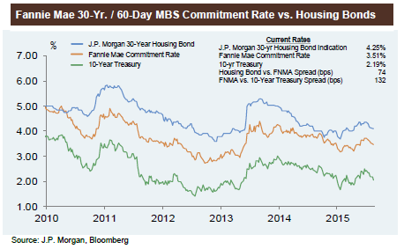
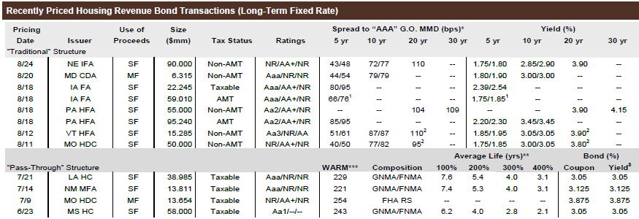
MMD and Bond Pricing

Slide 16
GSE Products for Affordable Housing
Freddie Mac Tax Exempt Loan (“TEL”)
1.15x DSC / 90% LTV / 7-30 year Term / 35-yr Amort
Sample Pricing (10yr fixed)
10Yr Treasury 2.40%
Guaranty Fee 1.85%
Servicing Fee 0.15%
TOTAL 4.40%
Forward Execution will likely add additional 20-30 bps

Slide 17
Loan Approval Process
Borrower contacts RICHMAC to start the quote process
RICHMAC contacts Freddie or Fannie or both to request for quotes
RICHMAC issues an Engagement Letter
Borrower signs the Engagement Letter
Kickoff the underwriting process
Collection of Due Diligence
Third Party Reports
Lender Site Inspection
Early Rate-Lock option
RICHMAC Loan Committee
RICHMAC submits the underwriting package to GSE
GSE Review of the submission
GSE Approval
RICHMAC issues a letter of commitment
Borrower Signs Commitment Letter
Rate-lock
Closing
Transfer note from RICHMAC to GSE
Front
End
Underwriting
GSE Review
Final Steps

Slide 18
TAKE A BREATHER
QUESTIONS?

Slide 19
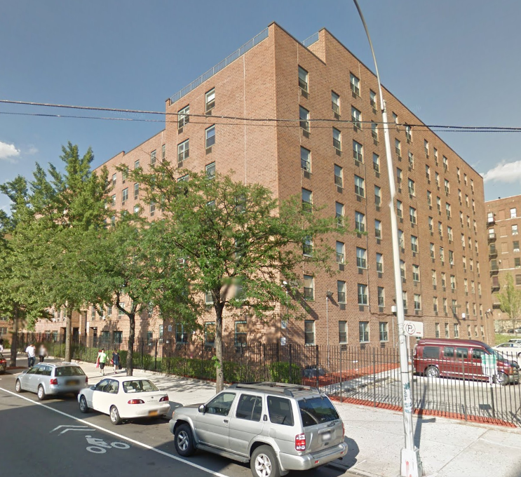
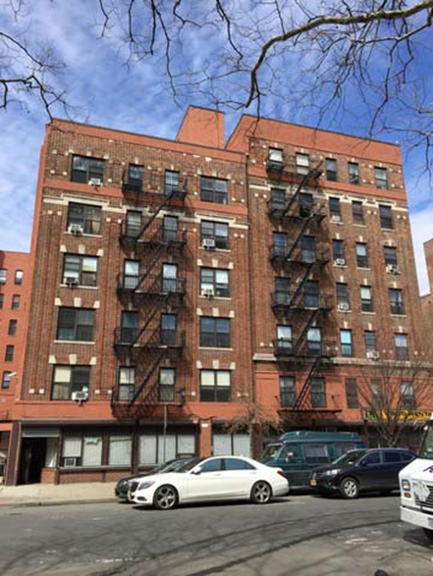
REPRESENTATIVE TRANSACTION
REPRESENTATIVE TRANSACTIONS
THESSALONICA & BROOKHAVEN APARTMENTS, BRONX, NY
Floating Rate Bridge Refinancing To Re-Syndication For Projects
Within Their 15-year Initial Tax Credit Compliance Period
THESSALONICA
$30,250,000
Freddie Mac 7-year Variable-Rate,
Years 6 & 7 open to Prepayment w/o Penalty
185bps + LIBOR
BROOKHAVEN
$14,225,000
Freddie Mac 7-year Variable-Rate
Years 6 & 7 open to Prepayment w/o Penalty
190bps + LIBOR

Slide 20
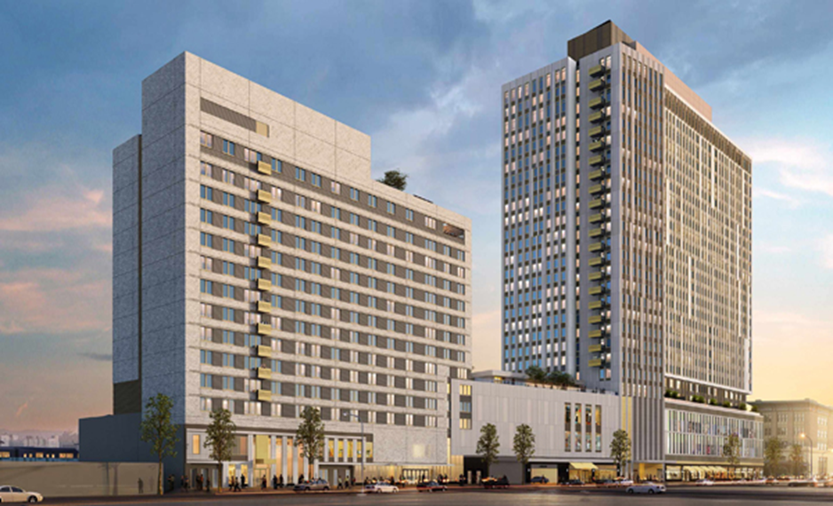
REPRESENTATIVE TRANSACTION
THE CROSSING AT JAMAICA STATION, QUEENS, NY
Forward Rate Lock Permanent Take-out for
Newly Constructed Mixed-Use Apartments (450 Units)
$158,00,000
Freddie Mac Variable Rate Bond Credit Enhancement, w/o Liquidity
30 Year Term, 6 Years Closed to Prepay, Open Thereafter w/o Penalty
129 Basis Points Guarantee Spread Over Quarterly Libor

Slide 21
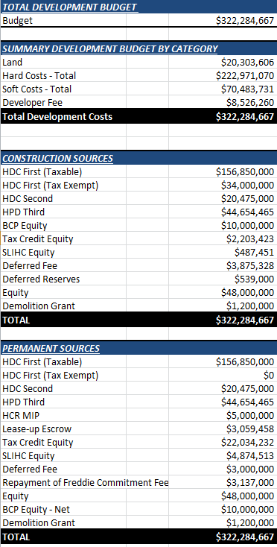
REPRESENTATIVE TRANSACTION
THE CROSSING AT JAMAICA STATION, QUEENS, NY

Slide 22
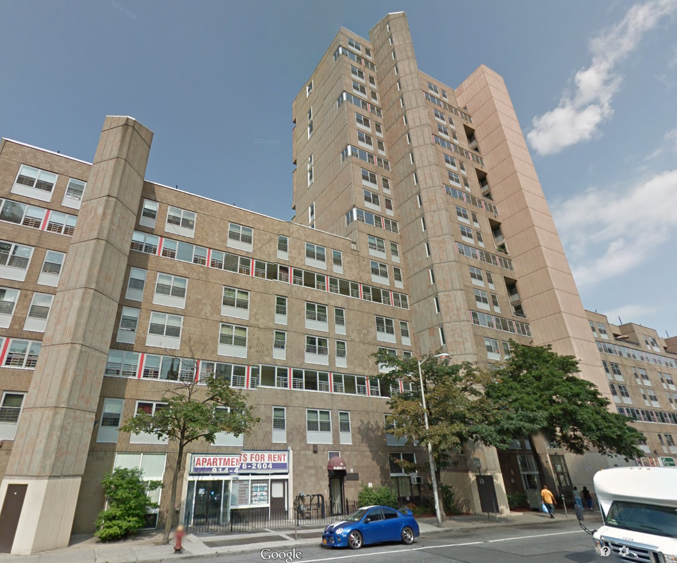
REPRESENTATIVE TRANSACTION
BUENA VISTA APARTMENTS, YONKERS, NY
Straight To Perm, In-place Rehab Financing with RAD Conversion (450 Unit Mitchell Lama)
$50,550,000
Freddie Mac Fixed Rate Bond Credit Enhancement
30 Year Term
125 Basis Points Guarantee Spread Over Fixed Rate 30 Year Bonds

Slide 23
REPRESENTATIVE TRANSACTION
BUENA VISTA APARTMENTS, YONKERS, NY

Slide 24
TAKE A BREATHER
MORE?

Slide 25
RICHMAC PRODUCT TYPES
PRODUCTS | FREDDIE MAC | FANNIE MAE | FHA/HUD
Cash Products
Immediate Acquisition/Rehab Fixed Rate | ✓ | ✓ | ✓
Immediate Acquisition/Rehab Variable Rate | ✓ | ✓
Bridge Financing (Variable & Fixed Rate) | ✓ | ✓
Forward Commitment Fixed Rate Takeouts of Construction Loans (New Const. & Major Rehab) | ✓
Forward Commitment Variable Rate Takeouts of Construction Loans (New Const. & Major Rehab) | ✓
Bond Products
Immediate Acquisition/Rehab Fixed Rate | ✓ | ✓ | ✓
Immediate Acquisition/Rehab Variable | ✓ | ✓
Bridge Financing (Variable & Fixed Rate) | ✓ | ✓
Forward Commitment Fixed Rate Takeouts of Construction Loans (New Const. & Major Rehab) | ✓ | ✓
Forward Commitment Variable Rate Takeouts of Construction Loans (New Const. & Major Rehab) | ✓ | ✓
Tax Exempt Loan Products
Fixed Rate Product | ✓
Variable Rate Product | ✓

Slide 26
FREDDIE MAC PRODUCTS
AFFORDABLE HOUSING PRSERVATION - Refinance or Acquisition Loan for Affordable Multifamily For 100% Affordable and Mixed Income Properties
BRIDGE TO RESYNDICATION - Provides efficient, short-term financing to acquire existing, stabilized LIHTC eligible properties and position them for recapitalization using 4% LIHTCs
REFINANCE LOAN FOR LIHTC TRANSACTION - Affordable multifamily properties with at least seven years remaining in the 10-year LIHTC period
TAX-EXEMPT BOND CREDIT ENHANCEMENT - Freddie Mac credit enhancement for tax-exempt bonds issues to finance the acquisition, new construction, refinance or moderate or substantial rehabilitation of multifamily properties.
TAX-EXEMPT LOAN - Loan in conjunction with 4% Low-Income Housing Tax Credits Cost-Effective Alternative to Tax-Exempt Bond Credit Enhancement
REVOLVING CREDIT FACILITY - Secured line-of-credit in which the borrower can move assets in and out of the facility while adhering to the defined credit parameters

Slide 27
FANNIE MAE PRODUCTS
TAX-EXEMPT BOND CREDIT ENHANCEMENT - credit enhancement for tax-exempt bonds issues to finance the acquisition, new construction, refinance or moderate or substantial rehabilitation of multifamily properties
MAH PRESERVATION REHAB EXECUTION- Permanent financing for Qualified Sponsors with an MAH property in need of renovations, eliminating the need for a construction loan. The property must achieve stabilization within 18 months of origination
MULTIFAMILY AFFORDABLE REFINANCE LOAN FOR LIHTC TRANSACTION -Affordable multifamily properties with at least eight years remaining in the LIHTC compliance period
REFINANCE WITH GREEN RETROFIT - Refinance or acquisition loans for affordable multifamily properties that are at least ten (10) years of age and will apply some proceeds from the refinance towards green property improvements.
REFINANCE OR ACQUISITION LOAN FOR AFFORDABLE MULTIFAMILY-Refinance loans for affordable multifamily properties with at least eight (8) years remaining in the LIHTC compliance period. Loan terms typically between 10-30 years;
ARM 7-4 -Variable-rate financing option with embedded caps and an option to convert to a fixed-rate loan

Slide 28
FHA/HUD PRODUCTS
SECTION 220 For Affordable Properties Or Market Rate Properties - Multifamily, New Construction, or Substantial Rehabilitation Loan for properties located within an Economic Development Area
SECTION 221(D)4 For Affordable Or Market Rate Properties - Multifamily New Construction or Substantial Rehabilitation Loan
SECTION 223(F) for Affordable or Market Rate Properties - Refinance or Acquisition Loan of Affordable multifamily properties that have been placed in service for at least three years
SECTION 223(A)7 - Streamlined refinancing of properties with existing HUD insured debt.
223(F) TAX CREDIT PILOT - Refinance or Acquisition Loan with 4% or 9% Low Income Housing Tax Credits that have been placed in service for at least three years

